Slide 1
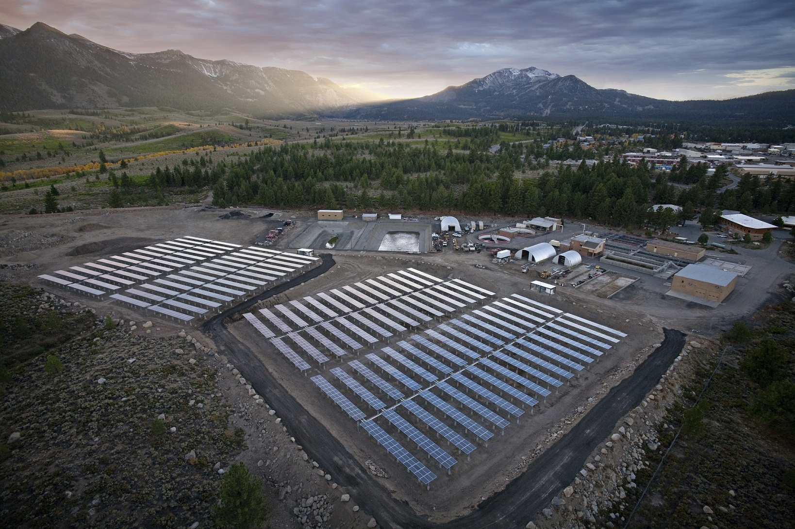
Mammoth Community Water District

Slide 2
Well Rehabilitation (Phase 1)
Forrest Cross
Associate Engineer

Slide 3
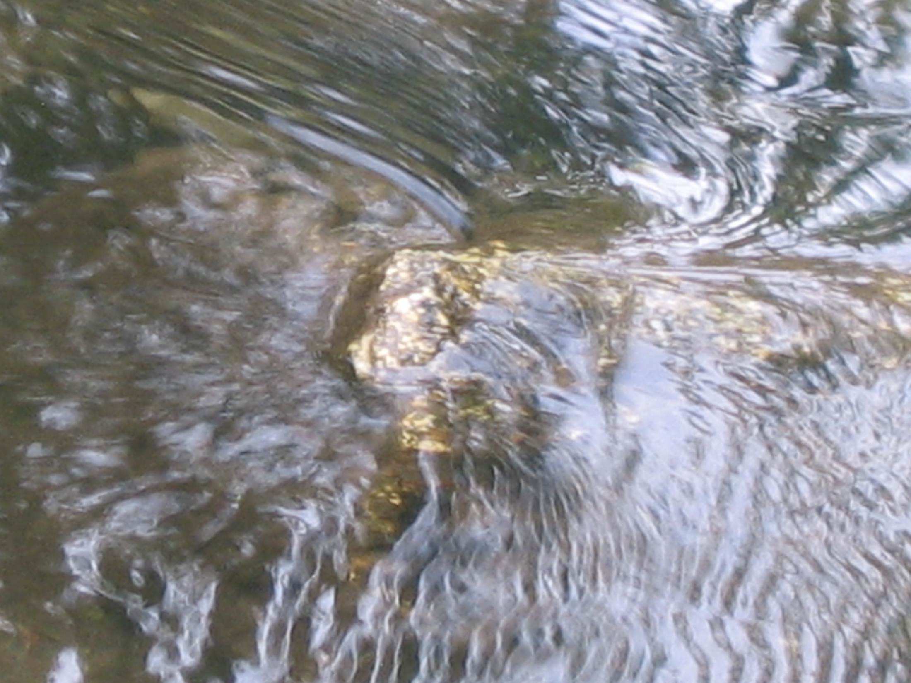

Slide 4
MCWD Stats
Number of services: 3,660 metered connections
Population: 8,200 resident, 35,000 with peak visitation
9 Groundwater Production Wells

Slide 5
Contaminants
Arsenic
Boron
Chloride
Iron
Manganese
TDS
Phosphorous
Silica

Slide 6
Mammoth’s Watershed

Slide 7
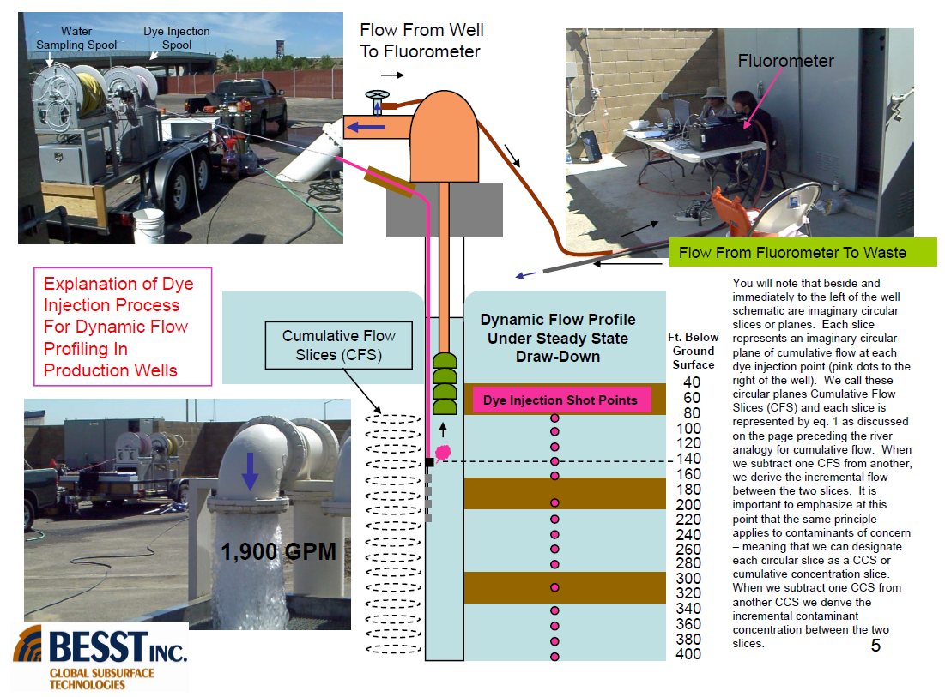
Mammoth’s Watershed

Slide 8
Mammoth’s Watershed

Slide 9
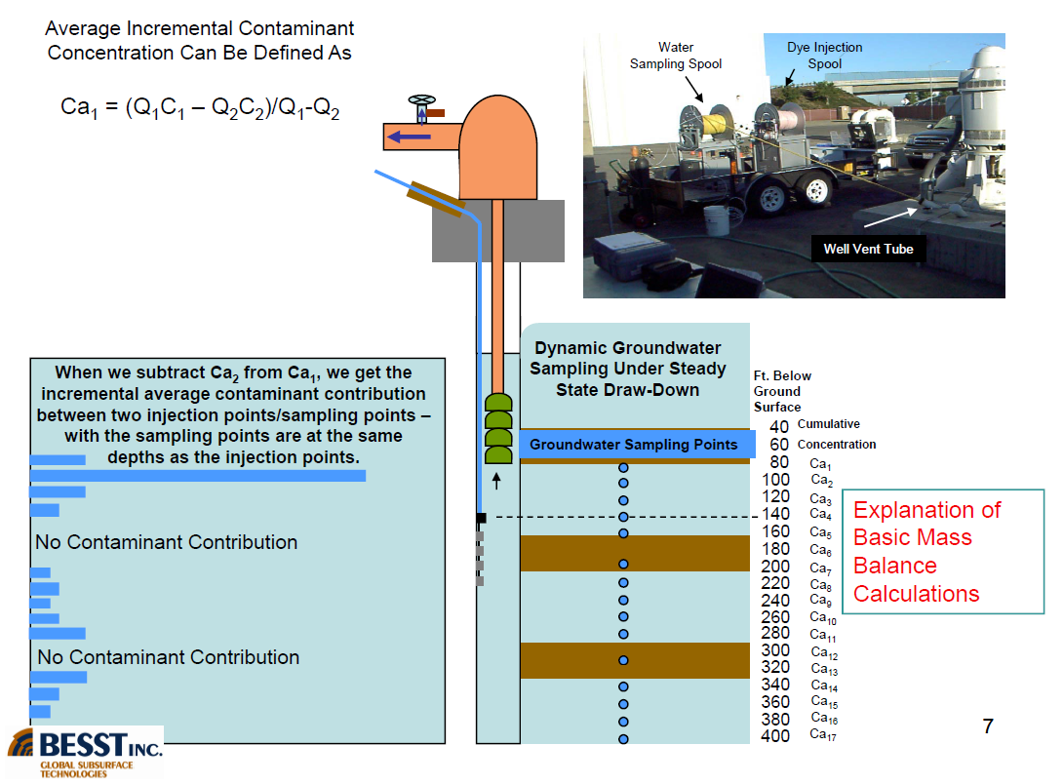
Mammoth’s Watershed

Slide 10
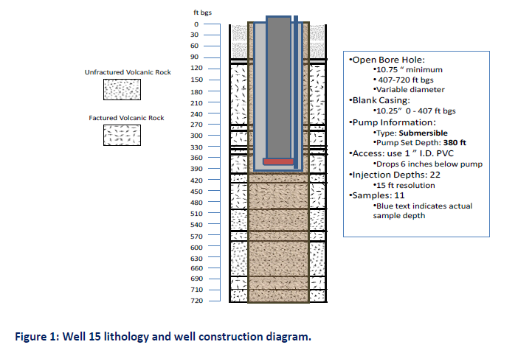
Mammoth’s Watershed

Slide 11
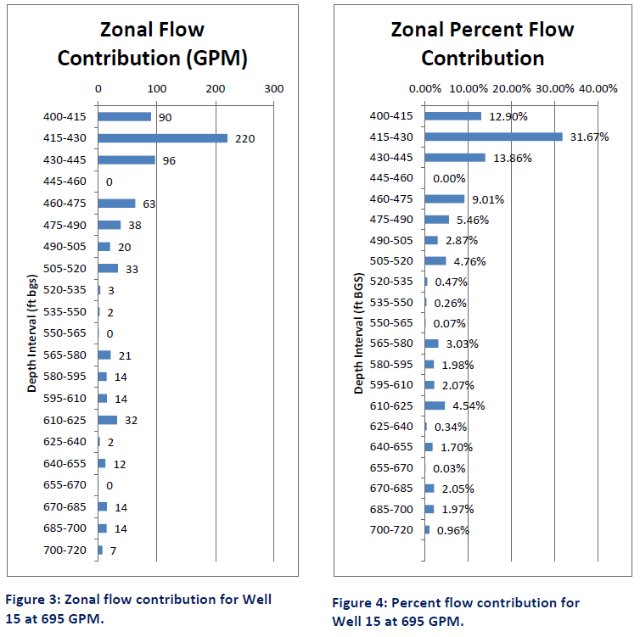
Mammoth’s Watershed

Slide 12
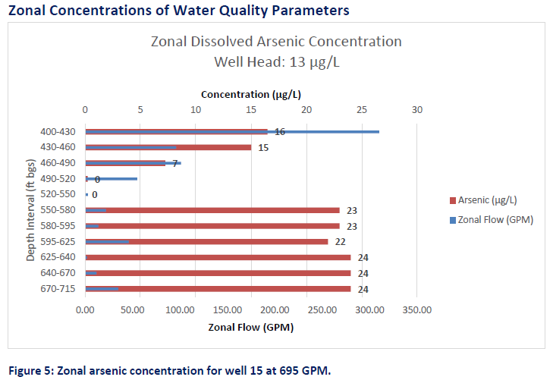
Mammoth’s Watershed

Slide 13
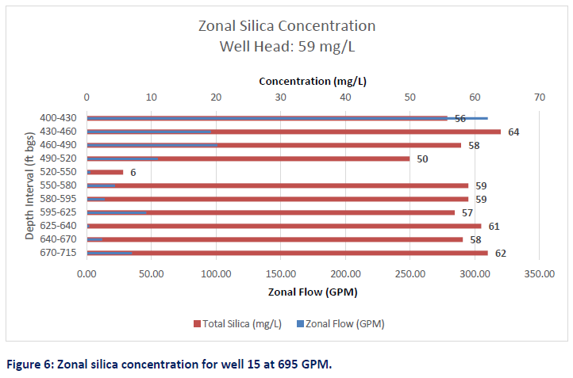
Mammoth’s Watershed

Slide 14
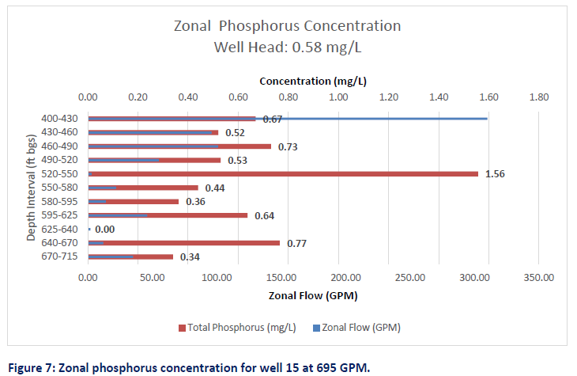
Mammoth’s Watershed

Slide 15
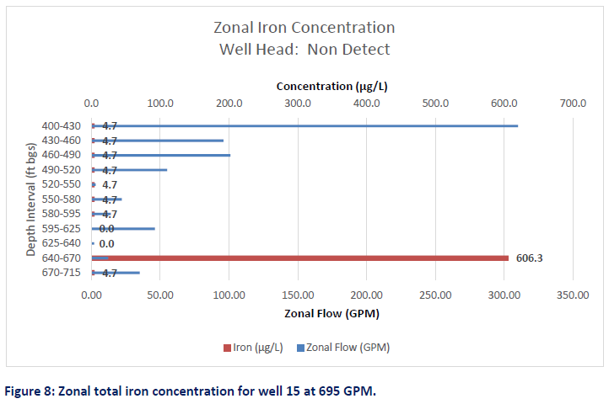
Mammoth’s Watershed

Slide 16
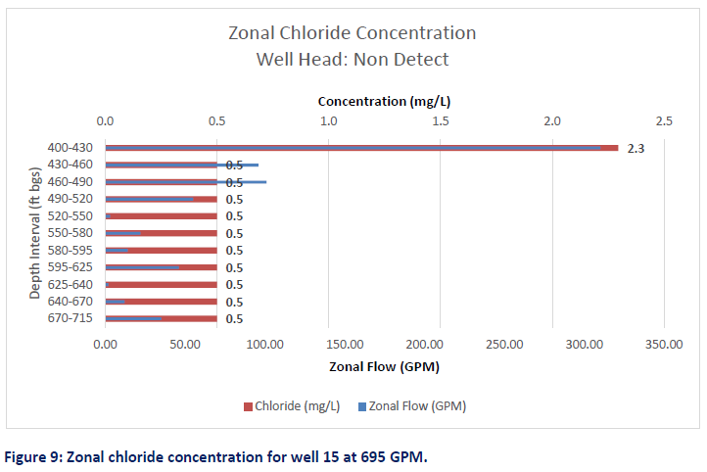
Mammoth’s Watershed

Slide 17
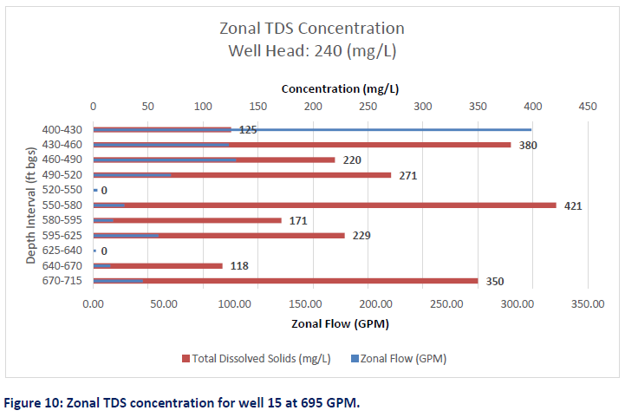
Mammoth’s Watershed

Slide 18
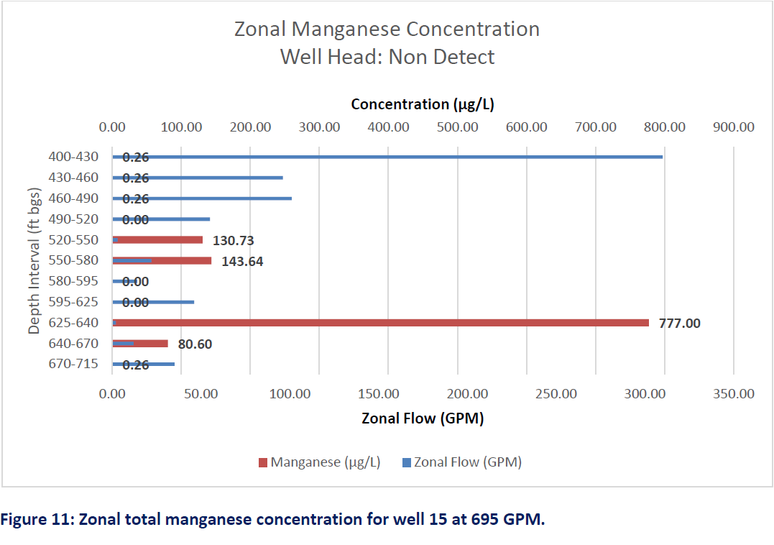
Mammoth’s Watershed

Slide 19
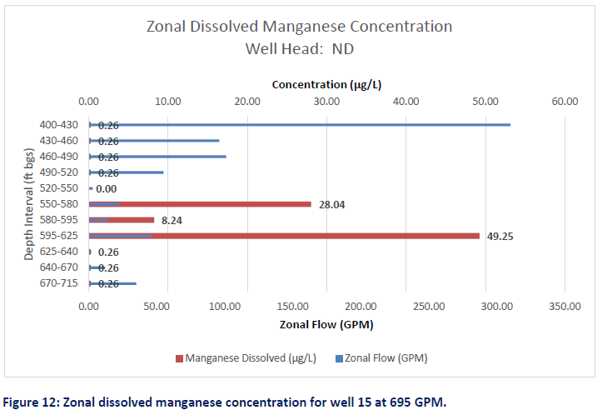
Mammoth’s Watershed

Slide 20
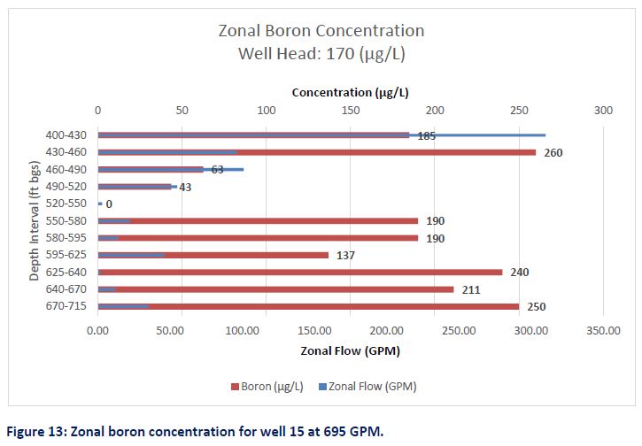
Mammoth’s Watershed

Slide 21
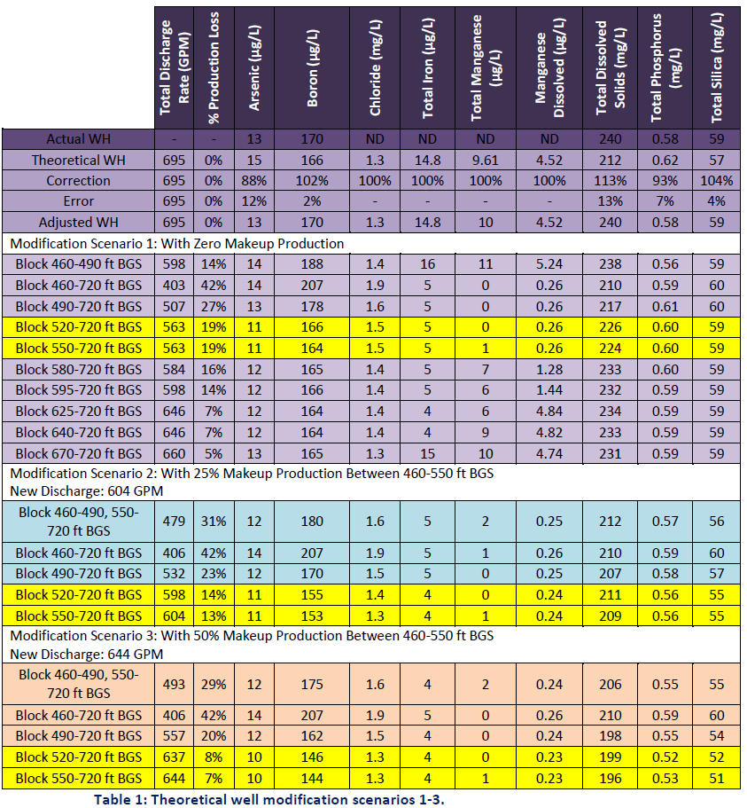
Mammoth’s Watershed

Slide 22
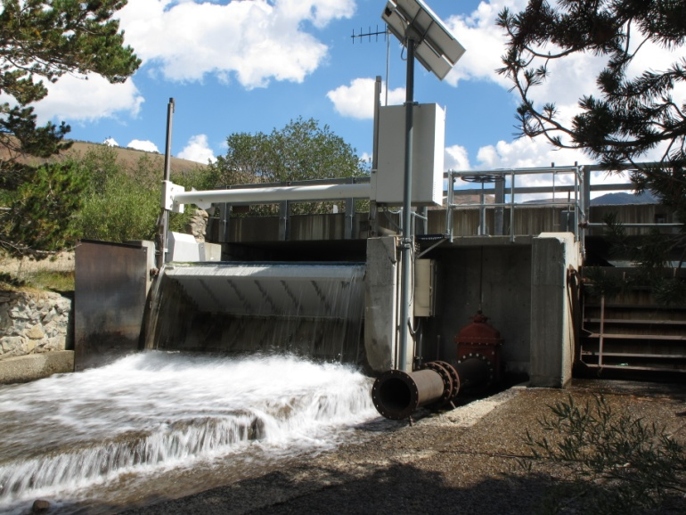
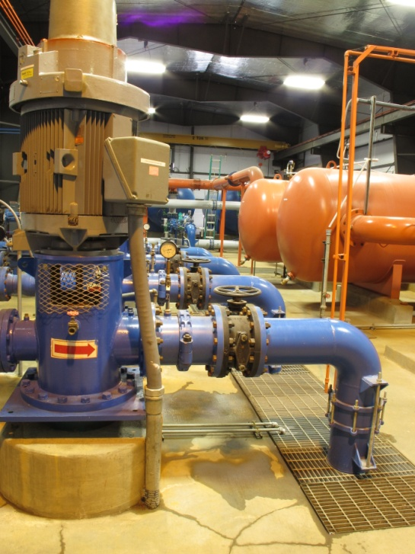
Water Supply
Surface, Groundwater, Raw and Reclaimed Water
Surface Water – Lake Mary
Limited by winter snow pack
Lakes Mary levels
Mammoth Creek flow levels
Priority source
Groundwater – 9 Production Wells
Limited by aquifer fluctuations
High energy demand

Slide 23
Mammoth Community Water District

