Slide 1
Oak Creek Restoration feasibility study
Jan. 2016
Todd Ellsworth – Inyo National Forest

Slide 3
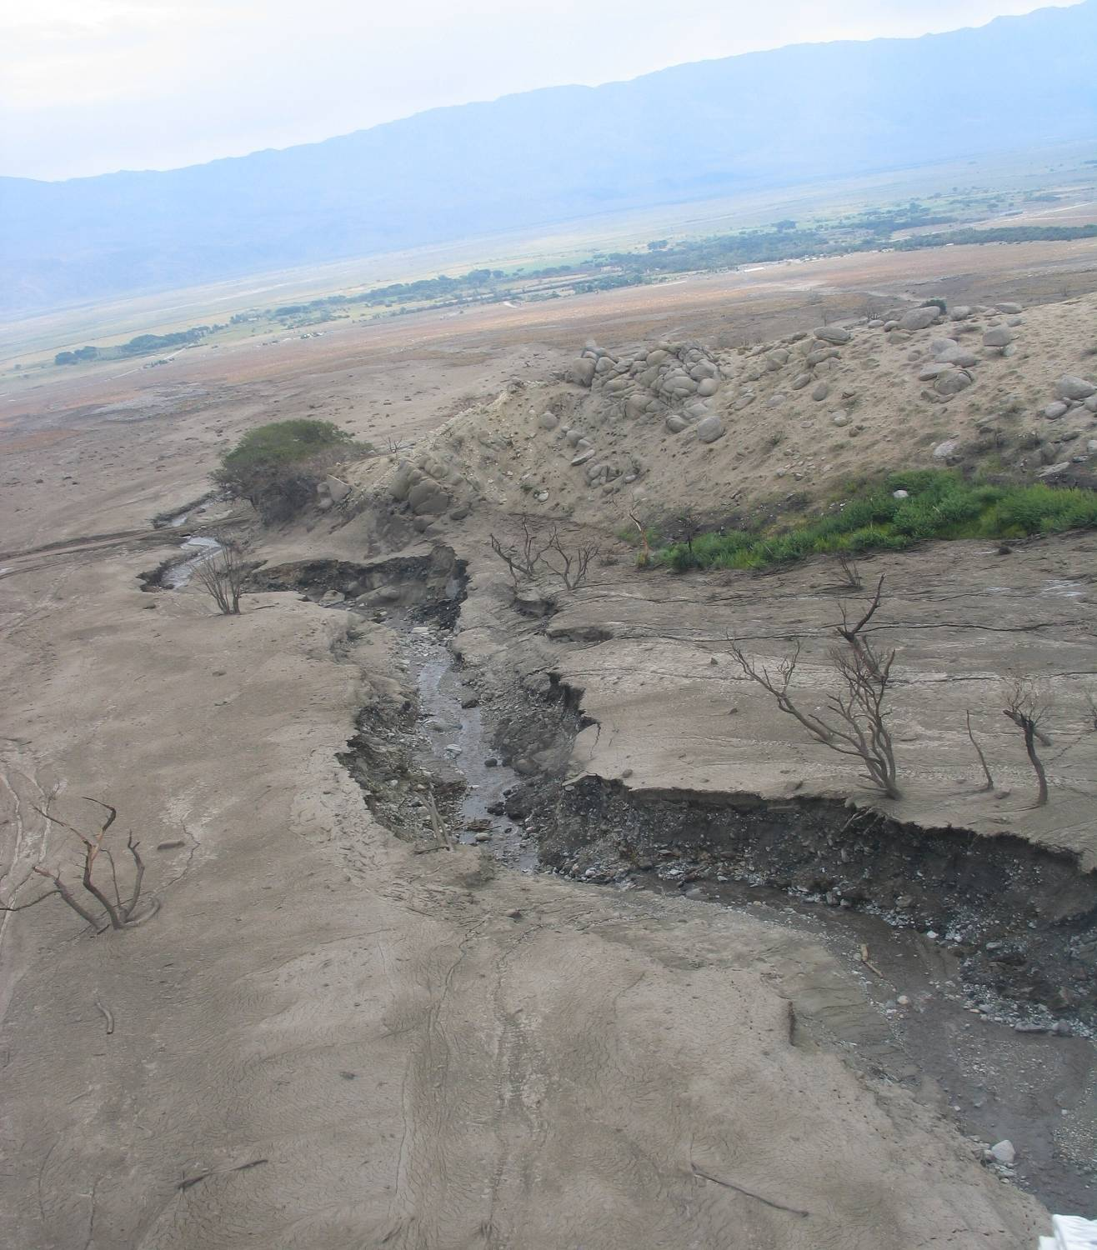
North Fork Oak Creek
Notes:
July 2008

Slide 4
Hillslope erosion
Notes:
July 2008, upper watershed in fire area very unstable,

Slide 5
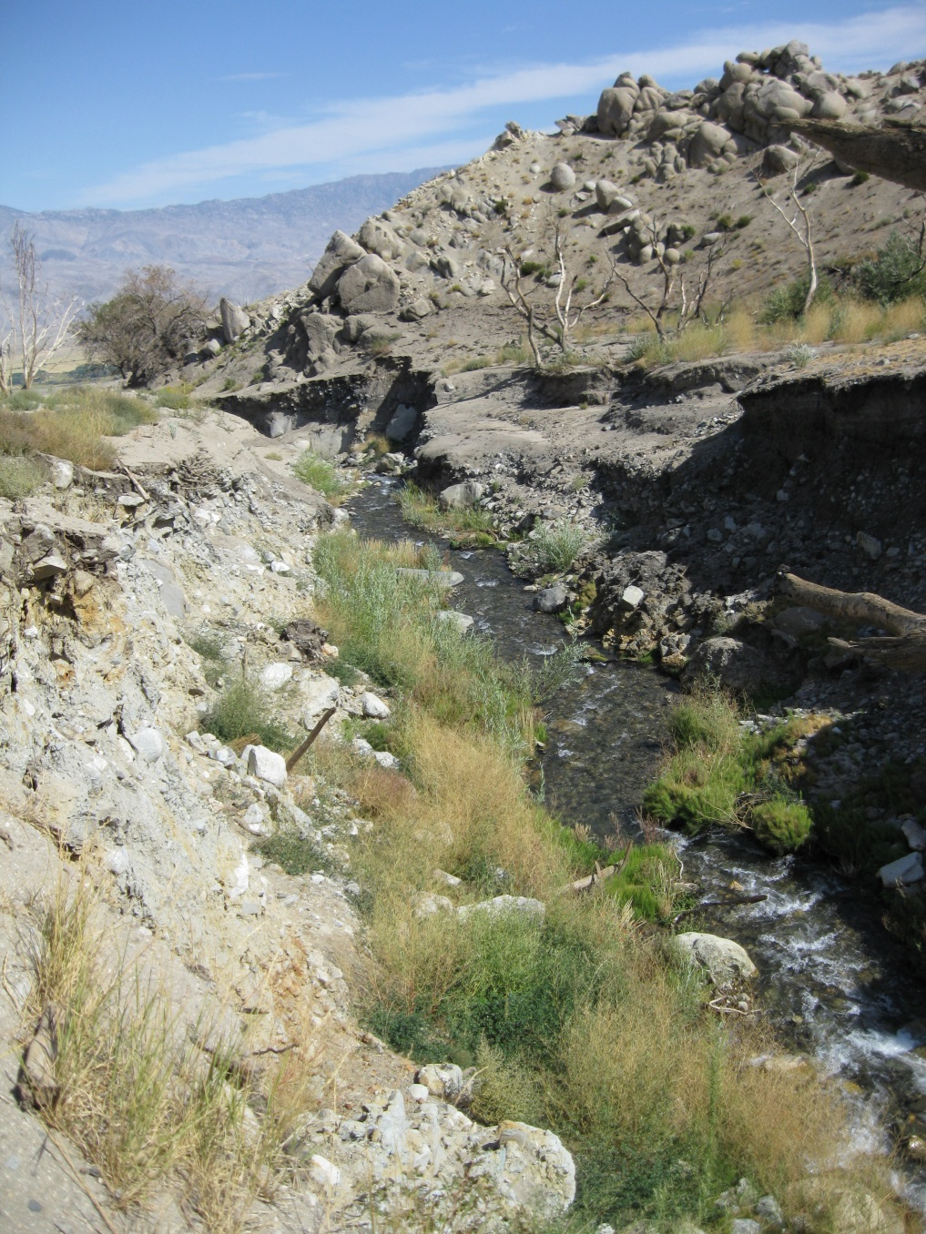
North Fork Oak Creek
Notes:
Jan 2010

Slide 6
North Fork Oak Creek
Notes:
March 2015

Slide 7
Restoration Study
Regional Priority through IRWMP process
Report produced with recommended actions on both North and South Fork Oak Creek

Slide 8
North Fork Oak Creek – Russian Thistle

Slide 11
South Fork Oak Creek
Notes:
Potential treatment area.

Slide 12
Next Steps
Worked with SNC and Trout Unlimited – received funding to do required environmental documentation (NEPA/CEQA and water quality permits)
Will likely apply to SNC (other funding sources??) this fall for an implementation grant…additional partners???

Slide 13
Thank you
Thanks to IRWMP staff and members for providing funding for this essential project!!!

